Slide 1

Controls Project Comparing LQR vs Convex MPC (ECOS and OSQP)
Mohammed Dawood

Slide 2
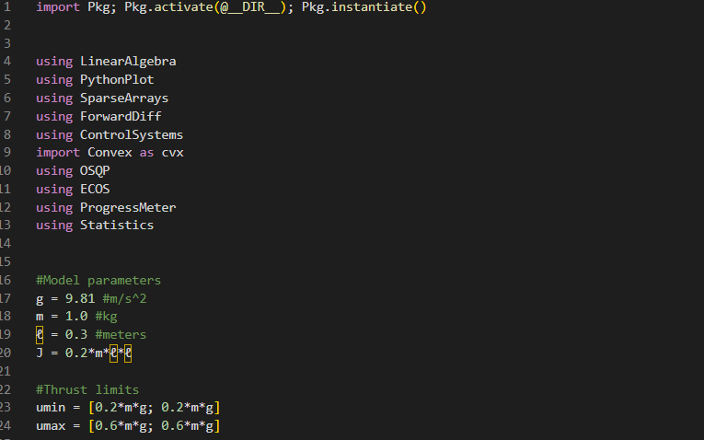
Setting Up The Problem

Slide 3
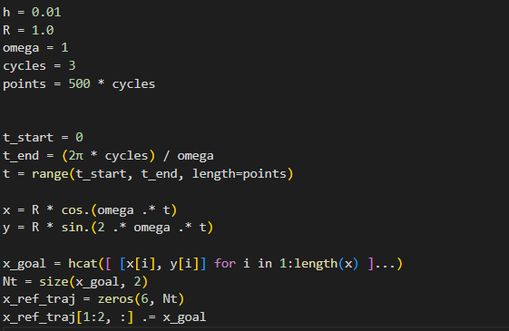
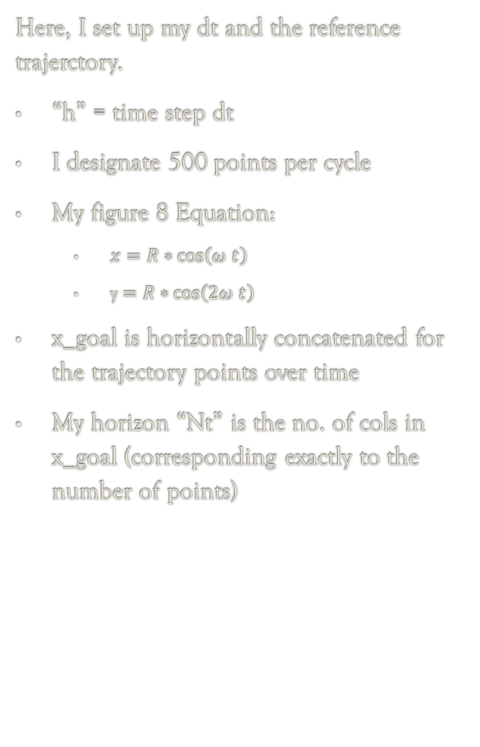
Here, I set up my dt and the reference trajerctory.
“h” = time step dt
I designate 500 points per cycle
My figure 8 Equation:
$x=R∗\cos\left(ω t\right)$
y $=R∗\cos\left(2ω t\right)$
x_goal is horizontally concatenated for the trajectory points over time
My horizon “Nt” is the no. of cols in x_goal (corresponding exactly to the number of points)

Slide 4
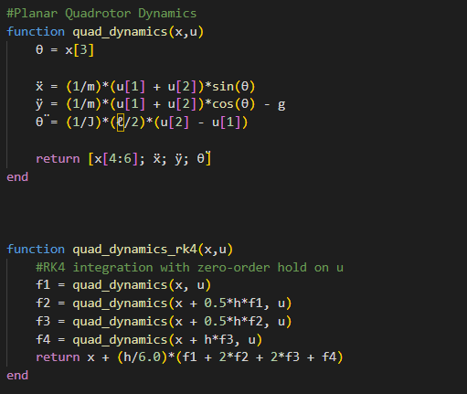
Here, I set up my quadrotor dynamics:
This has to be correct since it is extracted from the lectures
Three Degrees of Freedom
X, Y, and Pitch
Dynamics is simulated with rk4

Slide 5
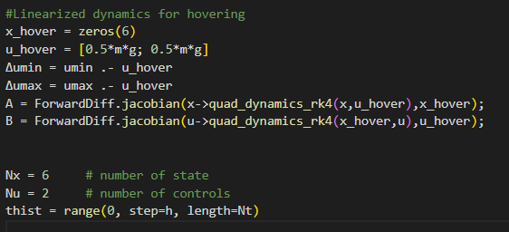
Here, I linearize my dynamics on the hovering point and x_hover = zeros:
U_hover is how much thrust each rotor to hover
I get delta umin and umax (useful for later)
A and B matrices linearized
Number of states and controls
And time vector specified

Slide 6

This is the LQR setup:
I put more weight on the trajectory tracking.
R weights set at 0.1 and 0.1
Using dare and dlqr to find the P and K matrices.

Slide 7
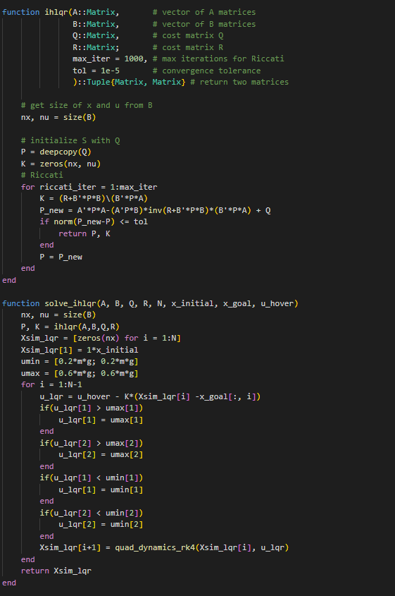
Infinite Horizon LQR:
The function takes A B Q R
Computes P and K matrices through ricatti recursion (I used this mainly the dare and dlqr were for sanity checks)
Finds K until convergence to a certain tolerance
Now I solve the ihlqr and simulate
I get the K matrix
Enforce hard constraints
I simulate using the feedback control loop: u = u_hover – K(Xsim – x_goal)
Feedforward term required
Simulated using rk4 since we have a nonlinear problem

Slide 8
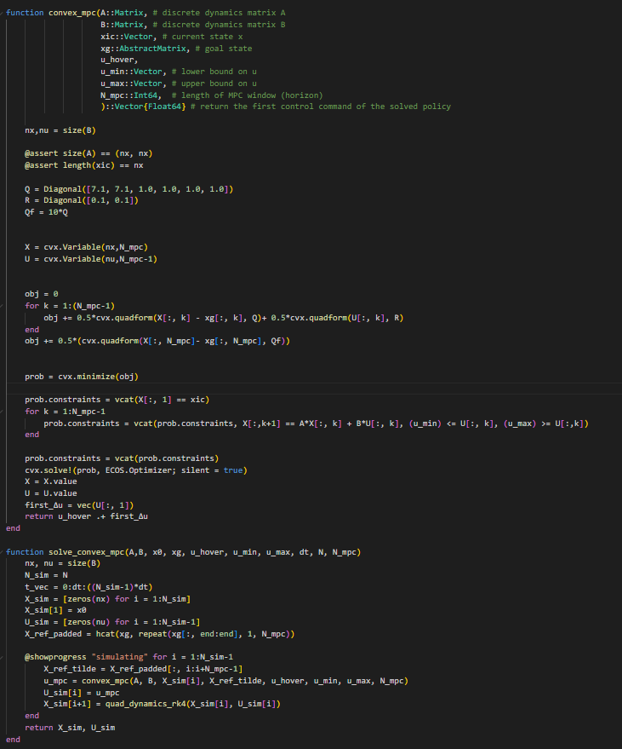
Convex MPC:
Q and R same weights (don’t worry; Qf set at 1*Q (old picture)
Cost function given
Constraints set (Note: if I put constraint on umin without the delta it breaks).
Optimize using ECOS
Return u_hover + delta u
I then simulate my convex mpc using rk4
I pad the X_ref so that the N_mpc extra steps can still be tracked
Return only the first step

Slide 9
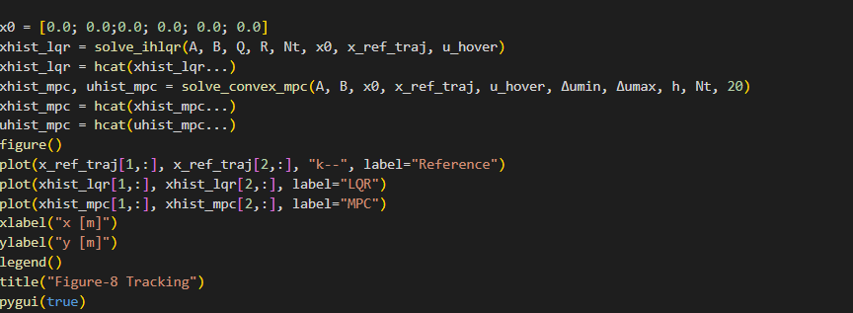
Initial Conditions
Solving for LQR and MPC
Plots

Slide 10
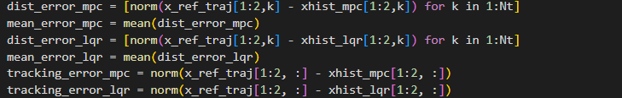
Calculating Tracking Error:
The distance between coordinates
Taking the norm between each distance
Stacking it into a vector
Taking the mean

Slide 11
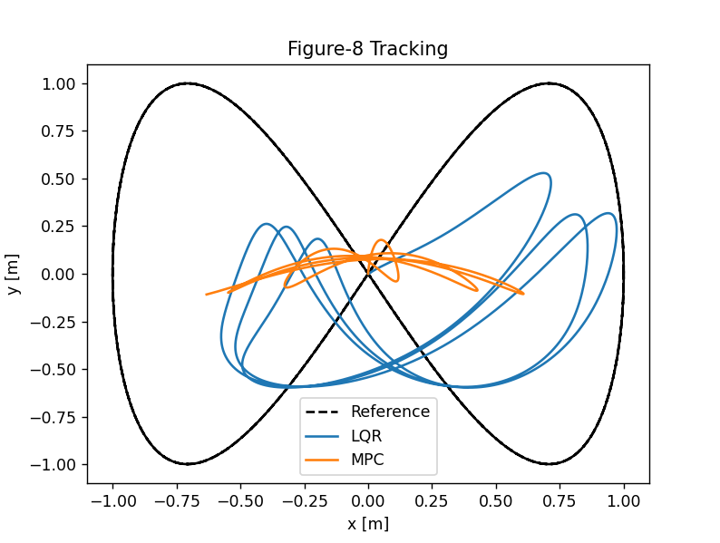
Results ECOS:
Tracking Error MPC_ECOS: 1.1435
Tracking Error LQR: 1.0624
Visually, LQR does follow a figure 8 path while MPC doesn’t

Slide 12
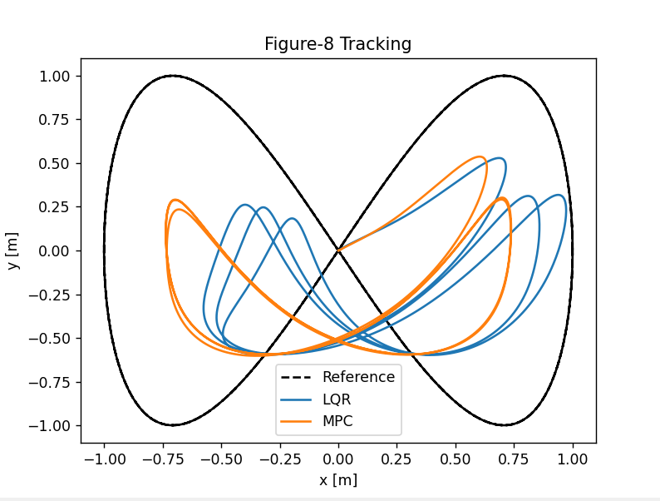
Results OSQP:
Tracking Error MPC: 1.1045
Tracking Error LQR: 1.0624
Visually, both follow a figure 8 path.
OSQP Code is extracted exactly from lecture code (shouldn’t have any problems)
So ECOS < OSQP < LQR

Slide 13
Acknowledgement of Certain Factors Affecting Results
The time step was a very important factor (rather than omega in this case). When setting a high time step, the drone follows the path closely and the differences don’t show. When setting a low time step, the drone starts showing differences among the methods.
The weights do matter. At lower Q’s, the tracking error for CVX MPC is better; however, this is “cheating” since it just stays very close the origin. On the other, LQR tries to follow the path and goes through the effort. Thus, I found it unfair to set low Q’s. For high Q’s, there is a certain point where the drones start not following the trajectory. In this case, my weights was closer to the latter case.
I set Qf as Q for CVX MPC for two reasons. First is the bullet point above. Second, it can be unfair since technically LQR didn’t take into account a Qf.
Finally, LQR was definitely faster

Slide 14
Possible Future Plans
Lecture 13-16 go through explaining rotations and lecture 16 simulates a drone with 13 state.
Implement TinyMPC through its Julia Package and I can manually implement to make sure I am correct and compare results.
TinyMPC uses ADMM (How are inequality constraints handled?)… Look at papers that use different optimization methods.
Ideas?

